Slide 1
Alpha Contributed SNC-60x0-488F
By
Robert Chu
On September 8, 2018 (For General Review)

Slide 2
Brief Description of SNC-60x0-488F
48 Ports of 25G SFP28 with 8 ports of 100G QSFP 28 Leaf Switch for Data Center
This SNC-60x0-488F is for either Enterprise or Carrier TOR switch.
It comes with ONIE and has three different CPU modules- Rangeley, Broadwell DE, and Denverton.

Slide 3

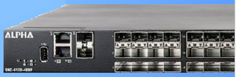
SNC-60x0-488F
  48 x 25 G SFP28 + 8 x 100G QSFP28

Slide 4
Product Brief
MAC Solution
  Trident3 2T (BCM56873)
I/O Configuration
  48 x 25G SFP28 + 8 x 100G QSFP28
  Serial console, Ethernet Management Port, USB for Storage
Modular Control Processor Board
  Intel Rangeley
  Intel Broadwell-DE
  Denverton
Resilient Design
  Redundant Power Supply (AC and DC)
  5+1 Hot Pluggable Fans
Specification
  Operation Temperature:
    Front to Back Air Flow (0~45ºC)
    Back to Front Air Flow (0~40ºC)
Dimension
  441mm (W) X 487.4mm (D) X 44mm (H)

Slide 5
Enhancement Options
Control Processor Board Options
  Intel Rangeley C2558 Four Cores/2.4GHz
    DDR3 4GB (maximum up to 32GB)
    M.2 SATA SSD 32GB (maximum up to 128GB)
    Boot Flash 8MB (maximum up to 16MB)
  Intel Broadwell-DE D-1518 Four Cores/2.3GHz
    DDR4 8GB (maximum up to 32GB)
    M.2 SATA SSD 32GB (maximum up to 128GB)
    Boot Flash 16MB (maximum up to 32MB)

Slide 6

Enhancement Options Continued..
Control Processor Board Options
  Intel Denverton C3958 Sixteen Cores/2.0GHz (with an options of 2 to 12 cores. Refer to the Appendix for more information.)
    DDR4 16GB * 2 (maximum up to 32GB) (with C3338 supporting only one 16GB)
    M.2 SATA SSD 64GB
    Boot Flash 32MB
    eMMC 16GB (reserved up to 32GB)
    TPM is optional
TPM (Trusted Platform Module)
  Nuvoton NPCT650

Slide 7
Main Board Diagram
Notes:
The SerDes is code-named as Falcon Core (32 of them.)
For 25g, with 56873 it can provide up to 80 SerDes lanes.

Slide 8
CPU board

Slide 9
Front Panel

Slide 10
Rear View

Slide 11

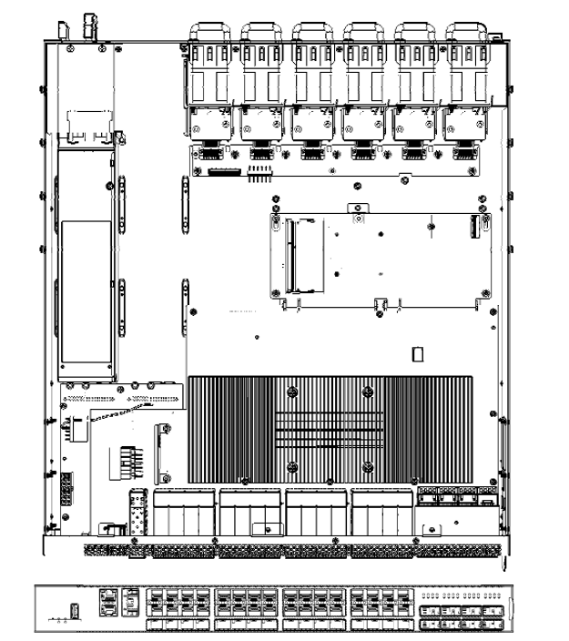
Chassis Dimensional Drawing

Slide 12
Top View

Slide 13
Different CPUs with its Management Ethernet Port

Slide 14
Some LED’s Definition

Slide 15
More of some LED’s definition

Slide 16
Some Regulatory Complianc

Slide 17
Other Reports Available

Slide 18
Take Home
SNC-60x0-448F is a Trident 3 switch for Enterprise and Data Center.
It provides 25G downlink and 100G uplink.
There are three CPUs supported in this switch. They are: a)Rangeley, b) Broadwell DE, and c) Denverton.
It comes with ONIE support.

Slide 19
Appendix

Slide 20
The Family of Denverton Supported

Slide 21
Some CPU Pin-out

Slide 22
Front panel picture

Slide 23
Alpha Recommends Cables for “Insert and Release” on Ports

